Slide 1
DevOps and Its Benefits

Slide 2
Table of Content
Introduction
Where did DevOps come from?
Breaking the Silos: Dev and Op
What is DevOps?
Problems led to the creation of DevOps
Dev and Ops Challenges and Solutions
Traditional Dev and Ops versus DevOps
DevOps Lifecycle Phases
Benefits of DevOps
Benefits of DevSecOps
Benefits of Using DevOps with Cloud and Cloud Platforms
DevOps Tools
How DevOps benefits Businesses
Final Thoughts

Slide 3
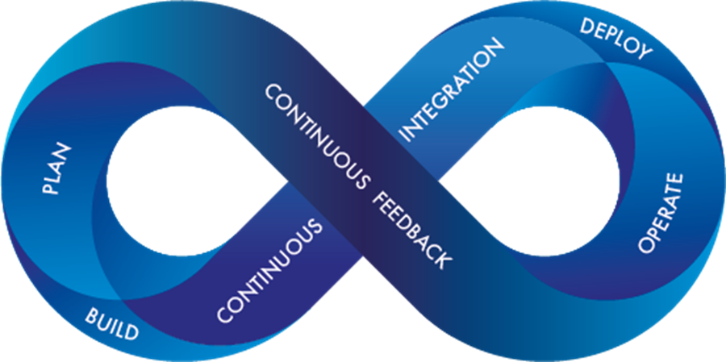
Introduction
As per the application economy today, businesses have become software businesses, and DevOps has become one of the most valuable business disciplines for enterprises.
With the help of DevOps, quality, and speed of application delivery have improved to a great extent.

Slide 4
Where did DevOps came from?
There are tons of stories about the DevOps origins, but it is not created out of the whole cloth. Its seeds were planted many years ago and recently nurtured by expert IT professionals in several disciplines. Two primary ancestors of DevOps are given below:
1. ESM (Enterprise Systems Management): People involved in the initial phases of DevOps are system administrators. These experts brought the key ESM practices to DevOps like configuration management, automated provisioning, system monitoring, and the toolchain approach, etc.
2. Agile Development: DevOps can be considered as an outgrowth of the agile. It is simply extending the Agile principles beyond boundaries of the code to the entire delivered services.

Slide 5
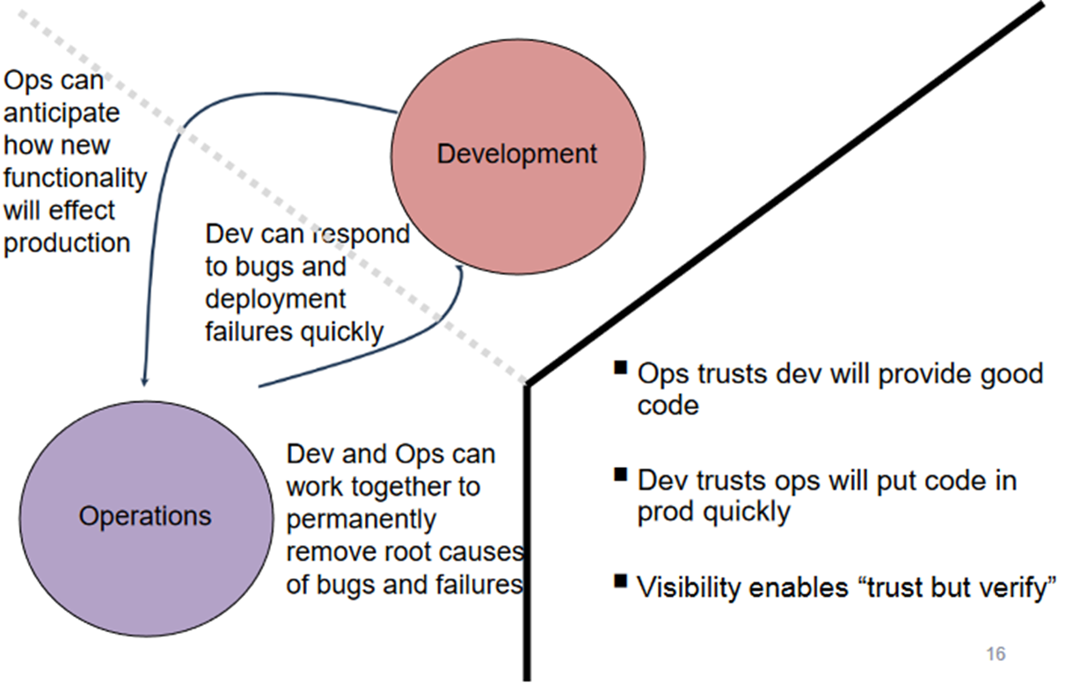
Breaking the Silos: Dev and Op

Slide 6
What is DevOps ?
DevOps word in itself is a combination of two words one is Development and other is Operations. It is neither an application nor a tool; instead, it is just a culture to promote development and Operation process collaboratively.
As a result of DevOps implementation, the speed to deliver applications and services has increased.
DevOps enables organizations to serve their customers strongly and better in the market.
DevOps is the process of alignment of IT and development operations with better and improved communication.

Slide 7
Problems led to the creation of DevOps
DevOps implementation has increased the rate of software delivery and the revenue for business stakeholders. Following listed reasons are the most considerable ones that led to the creation of DevOps.
Before DevOps, operation and development teams were working in an isolated environment.
Testing and Deployment activities mostly were performed in an isolated manner after design-build step, and they took more time than actual project completion time.
Team members usually spend a large amount of time in deploying, testing, designing, and building the projects
Human production errors were deployed during manual code conduction.

Slide 8
Dev and Ops Challenges and Solutions
Dev Challenges | DevOps Solutions
Code deployment time is higher | Quick deployment of code
Poor code management | Effective code management due to continuous integration
Ops Challenges | DevOps Solutions
Uptime maintenance is difficult | Maximum reliability of software Uptime
Automation tools are not so effective | Automation tools are highly effective
Server monitoring is tough | Continuous monitoring
Feedback is not given well | Continuous Feedback

Slide 9
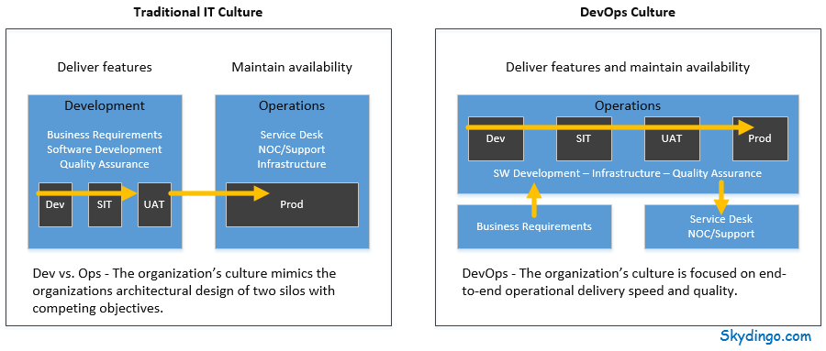
Traditional Dev and Ops versus DevOps

Slide 10
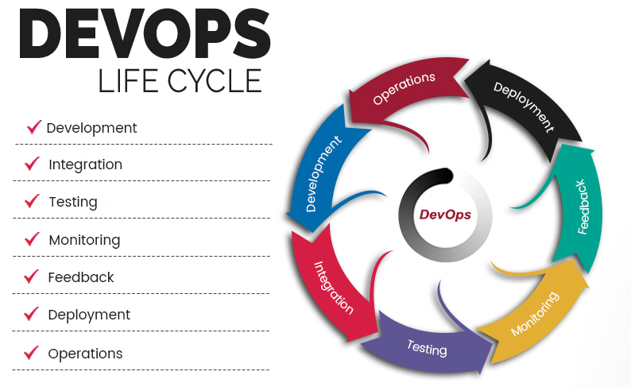
DevOps Lifecycle Phases

Slide 11
DevOps Lifecycle Phases (cont.)
Continuous Development:
Plan application objectives and Code the requirements
Continuous Integration:
Plan Tests and Build the product
Continuous Testing:
Verify the product for actual usage in a live environment
Continuous Monitoring:
Monitor the product output and find the problem areas

Slide 12
DevOps Lifecycle Phases (cont.)
Continuous Feedback:
Improvise the current product and helps to release new versions quickly
Continuous Deployment:
Ensures product is deployed with maximum accuracy
Continuous operations:
Automate release process with shorter development cycles
All DevOps operations are based on continuity with complete automation of the release process and allow organizations to accelerate the overall time to market on an ongoing basis.

Slide 13
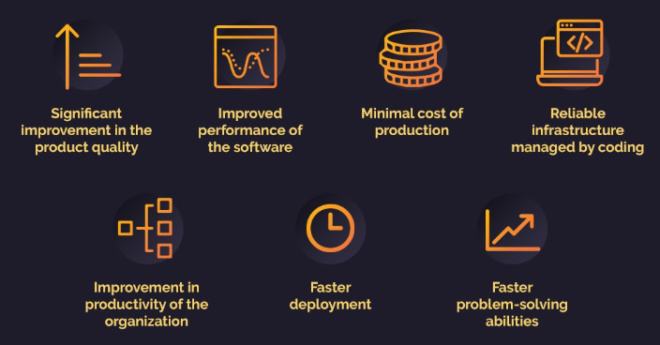
Benefits of DevOps

Slide 14
Benefits of DevOps (cont.)
Significant improvement in product quality: Collaboration between development and operation teams and frequent capturing of user feedback leads to a significant improvement in the quality of the product.
Continuous delivery of software: In DevOps methodology, all of the departments are responsible for maintaining stability and offering new features. Therefore, the speed of software delivery is fast and undisturbed, unlike the traditional method.
Minimal cost of production: With proper collaboration, DevOps helps in cutting down the management and production costs of your departments, as both maintenance and new updates are brought under a broader single umbrella.
Ensure faster deployment: Faster and more frequent delivery of updates and features will not only satisfy the customers but will also help your company take a firm stand in a competitive market
Fast and reliable problem-solving techniques: Ensuring quick and stable solution to technical errors in software management is one of the primary benefits of DevOps

Slide 15
Benefits of DevOps (cont.)
Lower Risk: Security aspects are incorporated in SDLC, and the number of defects gets decreased across the product.
Stability: DevOps implementation offers a stable and secure operational state.
Maintainability: The process improves the overall recovery rate at the time of the release event.
Automation in repetitive tasks leaves more room for innovation: DevOps has greater benefits when compared to the traditional model as it helps in detecting and correcting problems quickly and efficiently. As the flaws are repeatedly tested through automation, the team gets more time in framing new ideas.
Promotes agility in your business: It’s no secret that making your business agile can help you to stay ahead in the market. Thanks to DevOps, it is now possible to obtain the scalability required to transform the business.

Slide 16
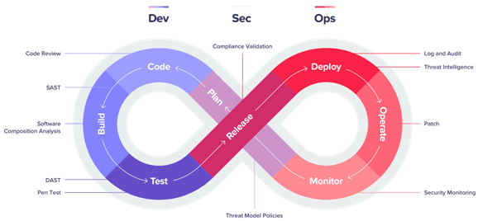
Benefits of DevSecOps
DevSecOps is an approach to providing security to applications and infrastructure based on the methodology of DevOps, which makes sure the application is less vulnerable and ready for users' uses.

Slide 17
Benefits of DevSecOps (cont.)
Developers don’t always code with security in mind. With a DevSecOps mentality, developers are enabled with enhanced automation throughout the software delivery pipeline to eliminate coding mistakes and ultimately reduce breaches.
Teams that implement DevSecOps tools and processes to integrate security into their DevOps framework will be able to release secure software faster.
Developers can test code for security and detect security flaws as code is written. Automated scans can be initiated as part of code check-ins, builds, releases, or other components of the CI/CD pipeline.
By integrating with tools developers are already using, dev teams can more easily improve the security aspect of web application development.

Slide 18
Benefits of DevSecOps (cont.)
The benefits of adopting security in DevOps:
Reduction of expenses and Delivery rate increases.
Security, Monitoring, Deployment check, and notifying systems from the beginning.
It supports openness and Transparency right from the start of development.
Secure by Design and the ability to measure.
Faster Speed of recovery in the case of a security incident.
Improving Overall Security by enabling Immutable infrastructure which further involves security automation.

Slide 19
Benefits of Using DevOps with Cloud
Easy Automation: Automation is an important aspect of the infrastructure management. Automating processes by leveraging cloud helps to enhance the pace of automation, makes the process more reliable, error free, robust and efficient, ultimately leading to reduction in time to market.
Cloud Server Replication: Every cloud provider has some backup mechanism. Even then there is a need to launch the servers manually and restore the backup on a different environment. Through DevOps, this process can be automated.

Slide 20
Benefits of Using DevOps with Cloud (cont.)
Effective Monitoring: DevOps can trigger custom alarms and various monitoring alerts enabling you to utilize resources more effectively.
Orchestration: The Orchestration is a specialized way of automation. Orchestration tools such as Chef, Puppet and Ansible are some of the intelligent tools in the market. They are independent of any of the cloud providers and have their own defined standards, but could be easily integrated with all the leading cloud providers. Integrating with cloud provides additional benefits such as automated server provisioning, auto-scaling and so on.
Rapid Deployment: DevOps focuses on solving the infrastructural problems with latest tools by building custom logic and writing capabilities. DevOps helps to automate the whole process using single click build tools that interact with the cloud services and get the tasks done without any errors.

Slide 21
Cloud: Amazon Web Services(AWS)
AWS is the safest cloud service platform offering
a wide range of infrastructure services like database
storage, computing power, networking etc.
By using more than 175 services in AWS, Users are
able to build scalable, complicated and flexible applications.
AWS has 55 availability zones with 8 more on the way.
One can experience AWS and do hands-on using
free-tier services.
Some popular clients of AWS include:
Netflix
Facebook
LinkedIn

Slide 22
Microsoft Azure
Azure is a cloud computing service created by Microsoft. It is a collection of various cloud computing services, including remotely hosted and managed versions of proprietary Microsoft technologies, and open technologies.
It is used for deploying, designing and managing the applications through a worldwide network.
Was known as Windows Azure, previously.
Supports various operating systems, databases, tools, programming languages and frameworks etc.
Azure has 44 availability zones with 12 more on the way.
A free trial for 30 days is available.
Some popular clients of Azure include:
Samsung
HP
Adobe

Slide 23
Google Cloud Platform
GCP uses resources located at Google data centers.
GCP is an integrated storage for live data, used by developers and enterprises.
Apart from the free trial, GCP offers various flexible Pay-As-You-Go payment plans.
Regions are available in Asia, Australia,
Europe, North America, and South
America. Each region is a collection of
zones, which are isolated from each other
within the region.
Some popular clients of Azure include:
Target
Goldman Sachs
Major League Baseball

Slide 24
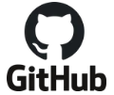
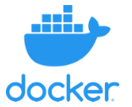
DevOps Tools
Tools | Description | Icon
GitHub | DevOps tools for easy collaboration. Using this tool, developers can make rapid iterations to the code, the notification of which is sent instantaneously to other team members.
Docker | Docker is a tool which is at the centre of containerization. Docker allows secure packaging, deploying and running of applications irrespective of the running environment.
Jenkins | An open-source continuous integration server, Jenkins automates the complete build cycle of a software project. The USP of this tool is the Pipeline feature it offers, which can be utilized by the developers to automatically commit code into the repository, run test cases, as well as fetch reports obtained after testing.

Slide 25
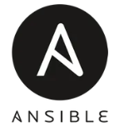
Tools | Description | Icon
Nagios | Nagios is a monitoring tool which tends to keep tabs on the applications, servers as well as your overall business infrastructure. It alerts the users in case a particular fault occurs on the backend or any device fails.
Slack | Slack is still one of the top communication tools used by teams for effective collaboration on projects. Slack is that it allows developers to collaborate using toolchains in the same environment they are communicating with other maintenance and service members.
Ansible | Ansible is one of the most simple yet effective IT orchestration. This tool is primarily utilized for pushing new changes within the existing system, as well as configuring newly deployed machines. Lowering the costs of infrastructure and increasing the replication speed of scalability are just two of the reasons which have made this an absolute favourite amongst IT companies.

Slide 26
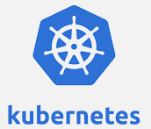
Tools | Description | Icon
Kubernetes | Also referred to as K8s, Kubernetes is an open source production-grade container orchestration system to automate the deployment, management, and scaling of contained-based software. Kubernetes is useful for applications packaged with many containers.
Terraform | One of the notable Infrastructure as Code DevOps tools in the market is Terraform by HashiCorp. It’s an open source IaC tool that offers a consistent Command Line Interface (CLI) workflow to help you manage several cloud services.
Selenium | It provides a portable framework to carry out the tests in addition to authoring functional tests with no need of learning a scripting language. It offers a test DSL, Selenese that you can use to author tests in various programming languages such as Java, PHP, Python, C, Perl, Ruby, etc.

Slide 27
How DevOps benefits Businesses
DevOps Benefit #1: Faster Deployment
DevOps benefits business by making faster deployment possible. Businesses can deploy new processes, systems and applications much more rapidly using DevOps strategies. This is because DevOps deployment will make your business operations more efficient.
You will be better able to deliver results faster, because the whole process of development and deployment will take much less time for employees to complete when they are working together. This is advantageous from a business perspective. It allows you to consistently improve business timing for delivering results.
Ultimately, faster deployment is one of the best business benefits for DevOps that all owners understand the value of.

Slide 28
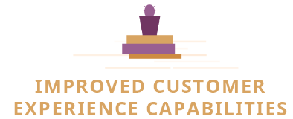
How DevOps benefits Businesses (cont.)
DevOps Benefit #2: Improved Customer
Experience Capabilities
When your business develops proprietary solutions faster, it is better able to serve business customers. That means that DevOps can actually help you improve customer service for your business.
In recent studies based on the advantages of DevOps for business, over 70% of businesses reported customer experience improvements since implementing a DevOps program. This is clearly a huge advantage for business.
You can improve the customer experience, which will only serve to improve revenue and profits. This is one of the biggest DevOps business advantages that owners are clamoring to experience.

Slide 29
How DevOps benefits Businesses (cont.)
DevOps Benefit #3: Better Office Morale
Team morale experiences a boost from implementing DevOps. DevOps benefits business by improving office collaboration and communication.
The more employees communicate and work together, the better they work together. This improves employee camaraderie and boosts employee morale, which is why it is one of the most effective team management strategies.
When employees work together well, they are happier. When everyone is happier, the work gets done quickly and well without issue. This is one of the biggest business benefits for DevOps implementation.

Slide 30
How DevOps benefits Businesses (cont.)
DevOps Benefit #4: More Time for
Innovation
DevOps benefits for business also allow more time for innovating. After DevOps implementation, your business will streamline processes and improve efficiency. This leaves a lot more time for brainstorming and developing new ideas in the work schedule.
The more time your business has to innovate and improve, the more your business will grow and succeed.
The best companies in the world allocate time to their people to innovate, create new products, or try out different ways of achieving better results. This is sure to help your business grow and expand for the long term.

Slide 31
How DevOps benefits Businesses (cont.)
DevOps Benefit #5: Faster Problem
Solving Abilities
Implementing DevOps processes allows businesses to solve problems quicker. Obviously, there are huge advantages to being able to problem solve faster.
Process problems can cost your business a lot of money. The longer it takes to fix a problem, the more money is bled from your company’s coffers. When you are able to solve problems more rapidly, you can limit business losses to get back on track sooner.
If you want to improve problem solving capabilities at your organization, this is one of the business benefits for DevOps that cannot be forgotten.

Slide 32
Final Thoughts: DevOps Implementation Offers Many Advantages for Businesses
Chris DeGonia, Director of QA at International SOS, said on a recent podcast – “DevOps is definitely here to stay. It is something that teams really need to get their hands around if they are not already working in DevOps space. They need to scale up or skill up in order to make it. Because it’s not becoming a slower-paced world, we’re certainly facing a faster-paced world as we move forward.”

Slide 33
Thank You

