Slide 1
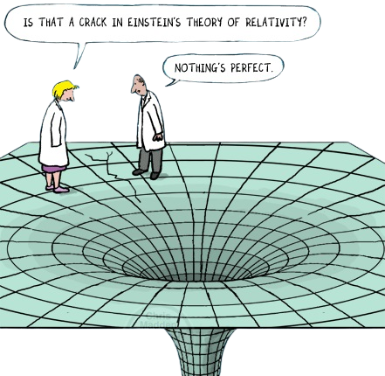
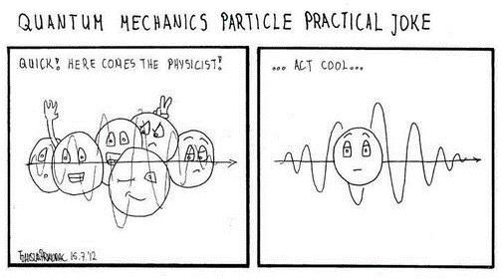
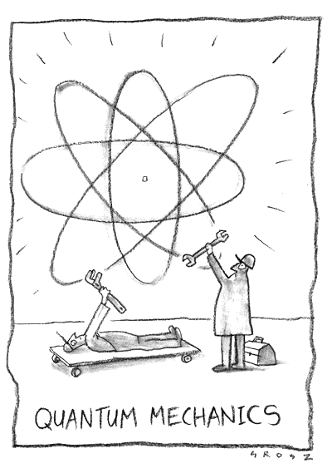
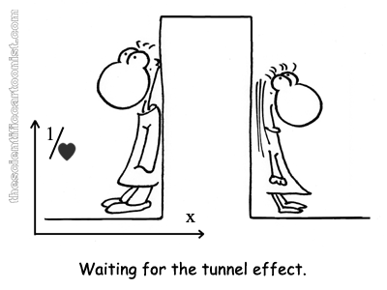
Quantum Computing Touching the Basics!
Saomya Chaudhury

Slide 2
MOOGLELABS - SERVICES
Decoding Innovation In AI/ML, Blockchain, DevOps and Data Science
Many organizations are afraid to take the leap toward AI/ML, Blockchain, DevOps, and Data Science. MoogleLabs makes the journey streamlined and smooth for you. Founded by seasoned IT experts, the company has the resources to help your business embrace new-age technology.
At MoogleLabs, we help you compete effectively by leveraging cutting-edge technology and in this endeavor, we have a talented team, which is certified in the technologies it works on. We have transformed businesses with our deep understanding of technology that can be utilized for various industries. The company is known for building a great client-business relationship by being transparent throughout the whole journey. MoogleLabs is always ready to better itself to provide the best services to its clients.
Artificial Intelligence
Machine Learning
Blockchain
DevOps
Data Science
Our Applied AI brings roadmap to scale enterprise-grade solutions, with the power of analytics, automation and next-level computing.
Scale up your business with future-ready ML-powered applications integrated with AR/VR, image & video analytics.
We help you build a secured decentralized solution for Smart Contracts, Crypto-token and NFT Marketplace.
We specialize in DevOps managed services including CI/CD, Infrastructure Management, Cloud Managed Services, DevSecOps, and AI Ops.
Uncover hidden stories in data and turn it into maximized revenue opportunities using qualitative and quantitative data processing techniques.

Slide 3
“To unlock the secrets of the UNIVERSE one must think in terms of Energy, Frequency & Vibration” Nikola Tesla

Slide 4
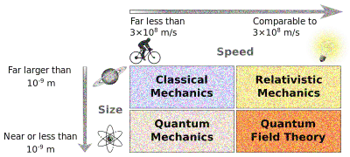
The world from Newton’s glasses (Classical Mechanics)
Proposed by Sir Issac Newton in 1687 in his legendary book ‘Naturalis Principia Mathematica’.
Applicable to ‘Macro’ scopic objects (humans, spaceships, planets, stars).
Highly accurate results for large–scale objects.
Speeds involving way less than the speed of light!
NOT applicable for extremely small particles (electrons). Why?
Notes:
Naturalis Principia Mathematica – will talk about Calculus. More specifically: Gradient Descent. Local Minimum.
Because electrons move at very high speeds.
Credits: https://www.clearias.com/classical-mechanics-vs-quantum-mechanics/

Slide 5
The SCALE of physical objects How much do we know?

Slide 6
Quantum Timeline
End of 19th Century
General consensus that all important laws of physics are discovered; remaining work is essentially “housekeeping”
1920's: Birth of Quantum Mechanics
Werner Heisenberg, Max Born, Albert Einstein, Erwin Schrödinger, Niels Bohr...
1927
Fifth Solvay International Conference on Electrons and Photons
1940’s
Birth of computer science (Alan Turing, Alonzo Church)
1982
Richard Feynman points out the intrinsic difficulties in making predictions on quantum systems (‘simulating quantum systems”); he suggests that building computers based on quantum mechanics could solve this problem.
1996
Discovery of a wide class of quantum error-correcting codes (CSS codes) by Robert Calderbank and Peter Shor, and Andrew Steane.
2001
First quantum factoring (15=3x5)
2011
D-Wave announces a quantum annealing device, called D-Wave One. This is the first commercially available quantum computing device (but not a universal quantum computer)
2019
Google announces Quantum Supremacy

Slide 7
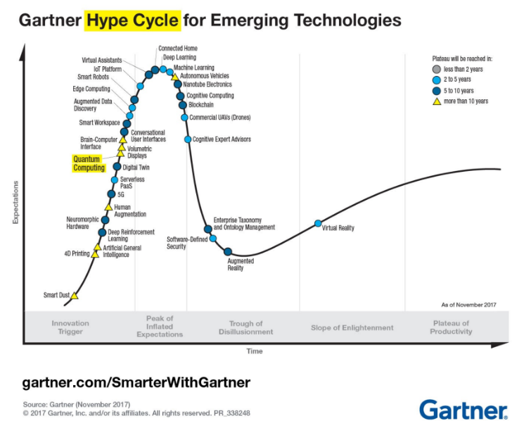

Slide 8
ATOMS and their REPRESENTATION…

Slide 9
Isn’t it a representation like this?

Slide 10
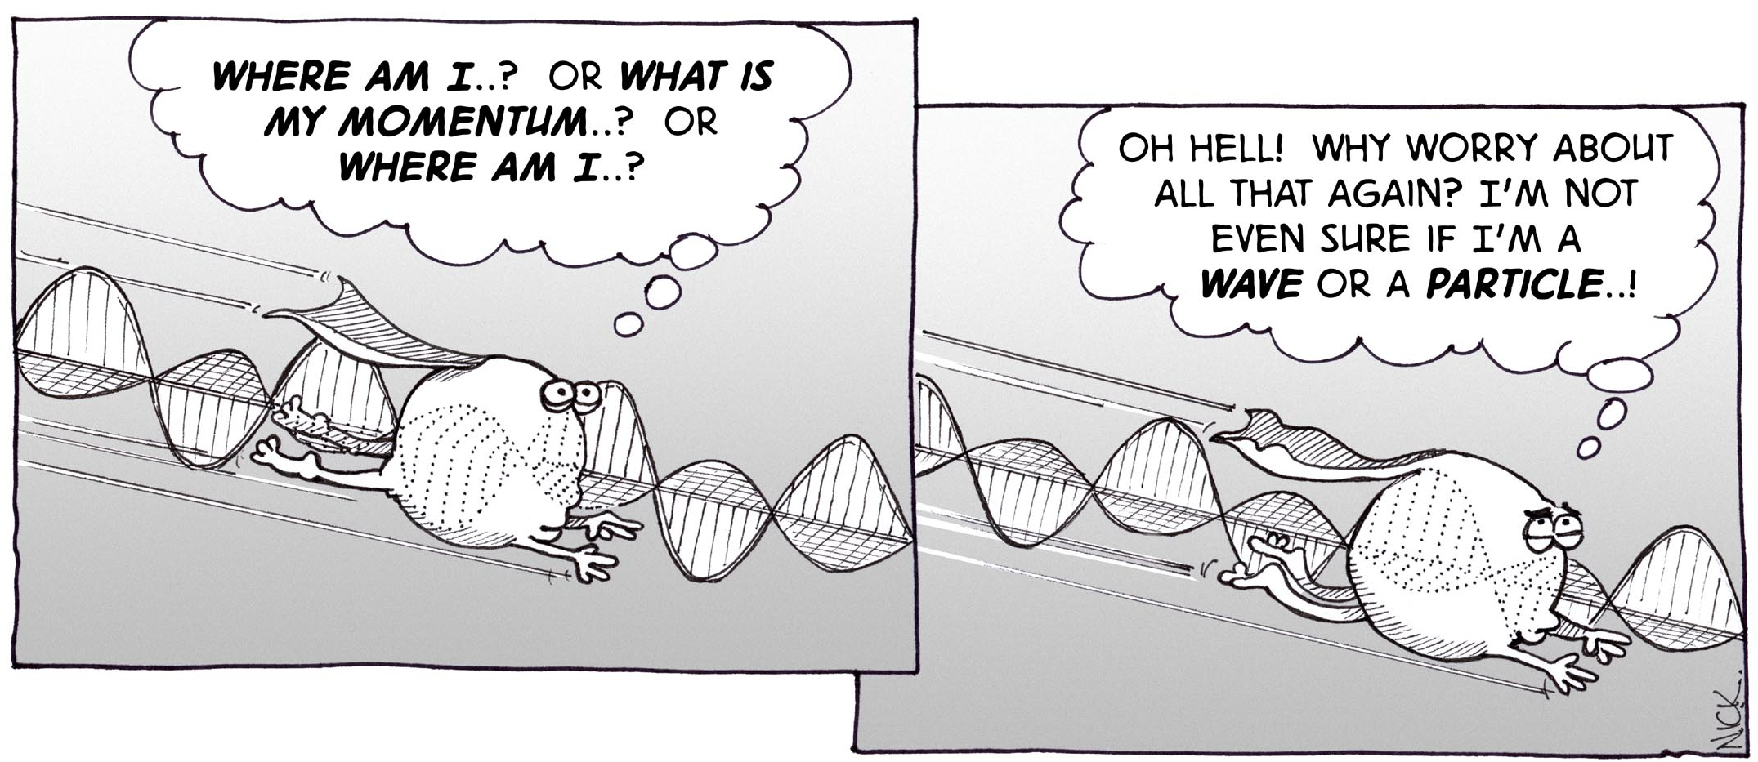
But wait – Is it complete? Well ‘NO’
Enter the strange world of
‘Quantum Mechanics’
Why? Elementary particles have ‘Dual Nature’ (thanks to De – Broglie):
Particle
Wave
Important characteristics that must be explained:
Position
Velocity
Energy
Probability

Slide 11
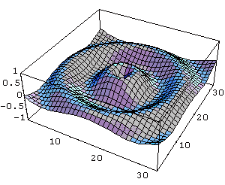
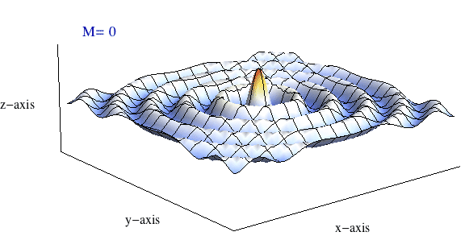
So how do atoms ‘REALLY’ look like?

Slide 12
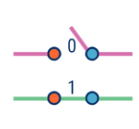
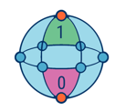
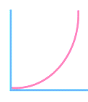
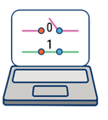
Classical vs Quantum – A war far from over!
PARAMETER | CLASSICAL COMPUTING | QUANTUM COMPUTING
Information storage | Classical Bits/ Bits | Qubits
Possible States | 0 OR 1 | Infinite (All possible states) |0⟩, |1⟩, ∣ψ⟩=α∣0⟩+β∣1⟩
Order of data processing | Sequential | Parallel
Calculations | Deterministic (you know your output) | Probabilistic (output is based on probabilities)
Operational Capability | Room Temperature | Ultracold temperatures --- Why??
Error rates | Low | High
Randomness | Falsely Random | Truly Random
Notes:
Complex Probability Amplitudes

Slide 13
Bit vs Qubit Maze

Slide 14
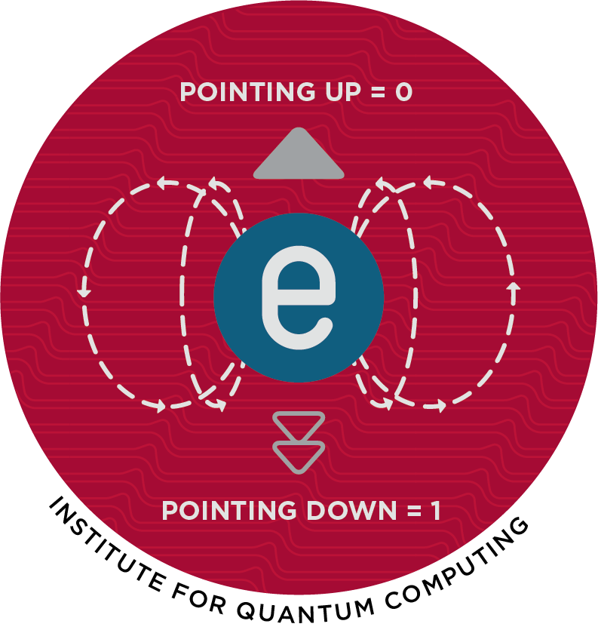
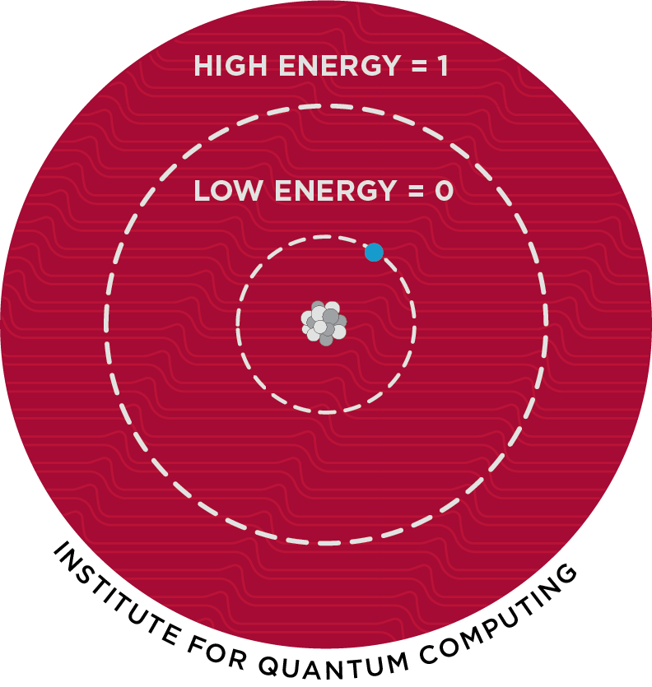
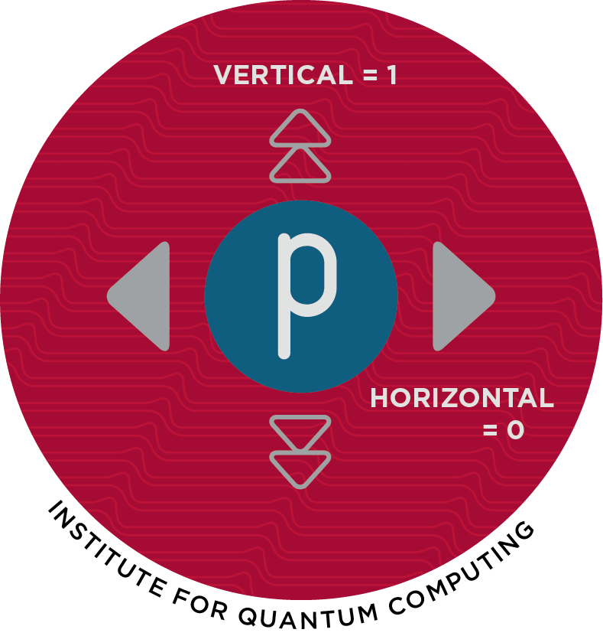
Qubit – The ‘Qu’antum Bit
Fundamental unit that carry Quantum information.
Can be 0, 1 or 0 and 1 at the same time.
Kinds:
Spin
Ions
Photon

Slide 15
Quantum Superposition
Results from dual nature of matter.
The non – zero probability of an electron to be in more than one distinct state.
So, until when it stays that way?
Until it is measured…

Slide 16
ALL POSSIBLE STATES AT ONCE!!!
Any two (or more) quantum states added together ("superposed") and the result will be another valid Quantum State

Slide 17
Quantum Decoherence (Inconsistence)
Increase in Qubits…
Problem!
Un – intended and unpredictable change in Qubit’s state by external interference in the system.

Slide 18
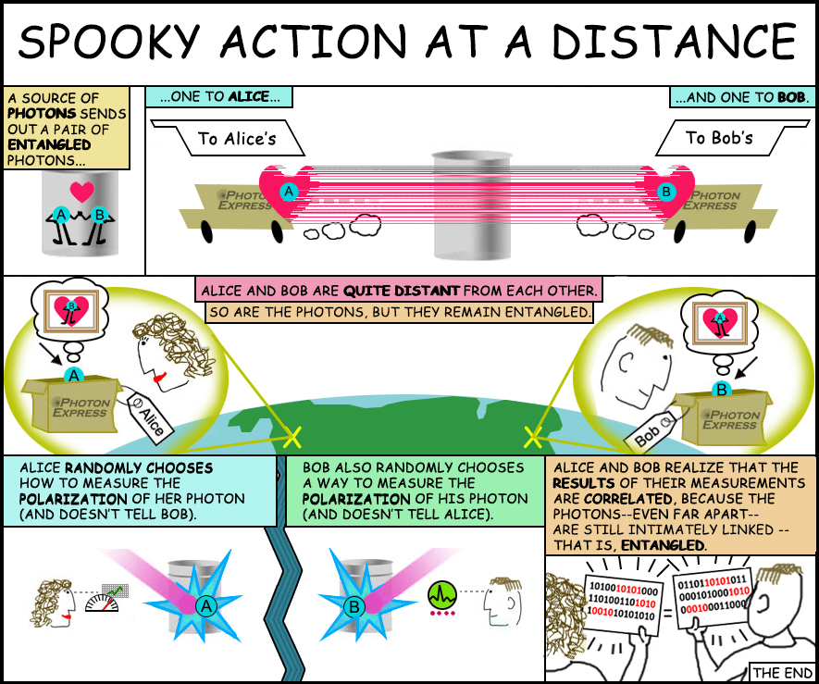
Quantum Entanglement
Measurement of one Qubit shall affect the measurement of other.
Without any Direct Interaction!!!
Property can be observed even if the 2 particles are far apart in space (be it Galaxies apart!)

Slide 19
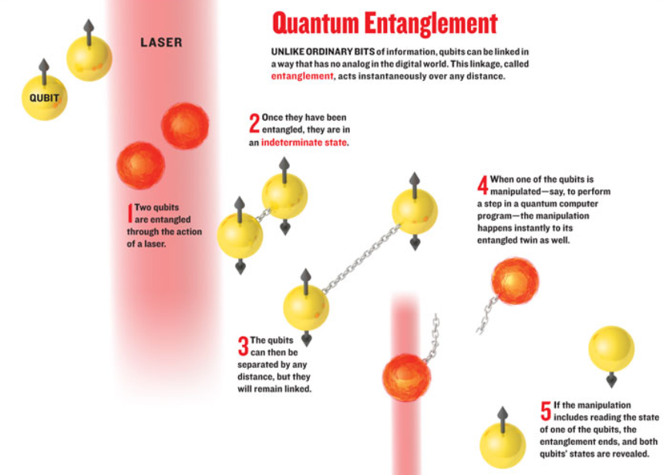
How does that happen?
2 entangled electrons existing in undecided states each hit with a photon.
Resultant is combined into a single wave and interpreted.

Slide 20
Cartoon Representation of Entanglement!

Slide 21
Quantum Supremacy
Also known as the Quantum Advantage
Programmable Quantum device that can solve a problem that no classical computer can solve in any feasible amount of time.
Status – Achieved
Year – 2019
Achieved by ‘Google’
Specifications: 54 Qubit processor; Name: Sycamore
Time taken by the best supercomputer – 10,000 years!
Target Achieved in 200 seconds!
Reference Paper: https://www.nature.com/articles/s41586-019-1666-5

Slide 22
“The important thing is NEVER stop questioning! Curiosity has its own reason for Existence…” Albert Einstein

