Slide 1
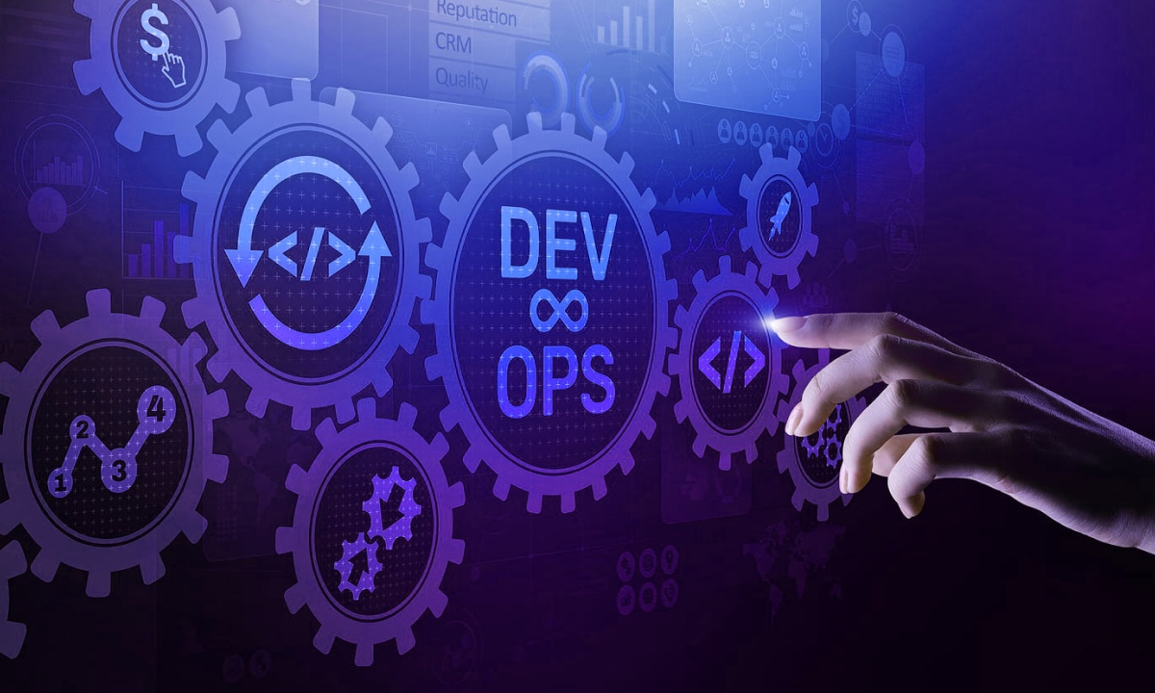
CI/CD WITH JENKINS
Presented By :
Arjit Chauhan DevOps Engineer
Mooglelabs

Slide 2
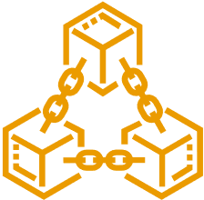
MOOGLELABS - SERVICES
Decoding Innovation" in AI/ML, Blockchain, DevOps, Data Science & Metaverse
Many organizations are afraid to take the leap toward AI/ML, Blockchain, DevOps, and Data Science. MoogleLabs makes the journey streamlined and smooth for you. Founded by seasoned IT experts, the company has the resources to help your business embrace new-age technology.
At MoogleLabs, we help you compete effectively by leveraging cutting-edge technology and in this endeavor, we have a talented team, which is certified in the technologies it works on. We have transformed businesses with our deep understanding of technology that can be utilized for various industries. The company is known for building a great client-business relationship by being transparent throughout the whole journey. MoogleLabs is always ready to better itself to provide the best services to its clients.
,
Artificial Intelligence
Machine Learning
Blockchain
DevOps
Data Science
Our Applied AI brings roadmap to scale enterprise-grade solutions, with the power of analytics, automation and next-level computing.
Scale up your business with future-ready ML-powered applications integrated with AR/VR, image & video analytics.
We help you build a secured decentralized solution for Smart Contracts, Crypto-token and NFT Marketplace.
We specialize in DevOps managed services including CI/CD, Infrastructure Management, Cloud Managed Services, DevSecOps, and AI Ops.
Uncover hidden stories in data and turn it into maximized revenue opportunities using qualitative and quantitative data processing techniques.

Slide 3
CONTENTS
Introduction to Jenkins
History
Architecture
Features
Plugins
Jenkins Pipelines and Jenkinsfile
Jenkins vs other CI/CD tools
Advantages
Installing and Configuring
Demo – CI/CD of React Application
,

Slide 4
INTRODUCTION TO JENKINS
Jenkins is an open source continuous integration/continuous delivery and deployment (CI/CD) automation software DevOps tools written in the Java programming language.
It is used to implement CI/CD workflows, called pipelines.
Jenkins is a self-contained , open source automation that can be used to automate all sorts of tasks related to building , testing and deploying software.
It uses the plugins for building and testing the project code continuously .
Jenkins can be installed through native system packages, Docker or even run standalone by an machine with a Java Runtime Environment (JRE) installed.
,

Slide 5
HISTORY
Jenkins is a fork of a project called Hudson, which was trademarked by Oracle.
Kohsuke first developed Hudson 2004 while working at Sun Microsystems. When Oracle acquired Sun Microsystems in 2010, there was a dispute between Oracle and the Hudson community with the respect to infrastructure used.
Kohsuke wanted to create a method to perform continuous integration,the idea was to test the code before committing to avoid the breaking builds.
On Jan 11, 2011, a call for votes made to change the project name from Hudson to Jenkins.
On Jan 29, 2011 , creating the first Jenkins project.
,

Slide 6
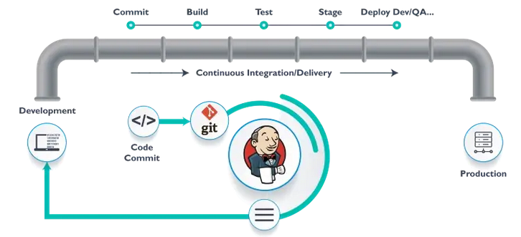
ARCHITECTURE
,

Slide 7
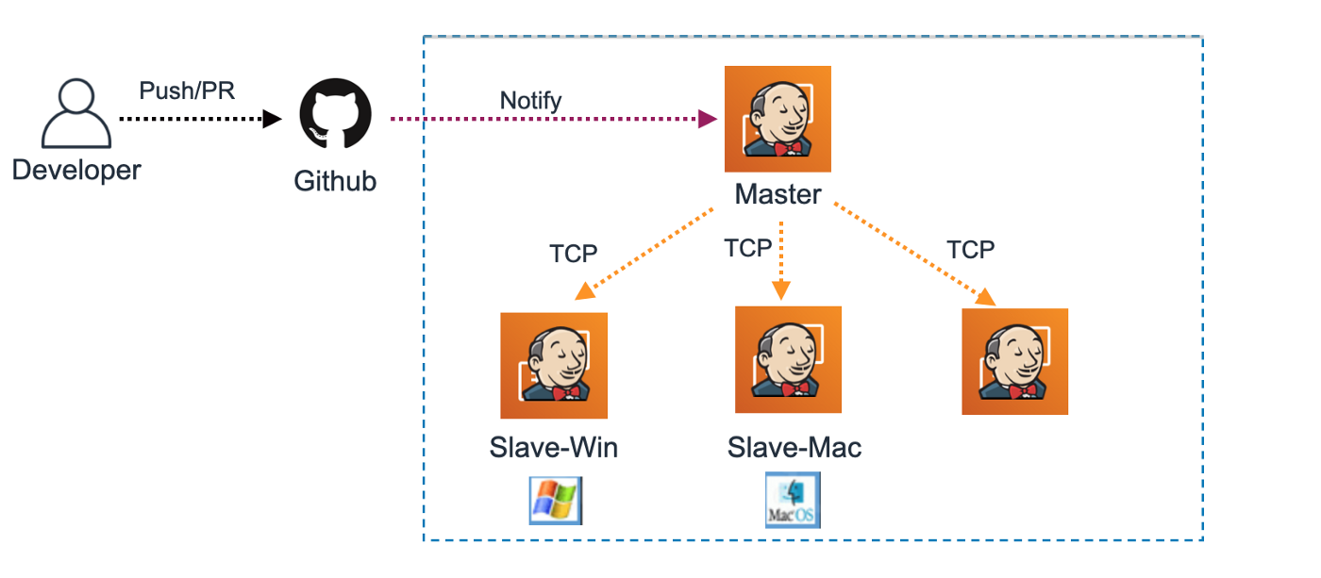
JENKINS MASTER AND JENKINS SLAVE
Jenkins Master is the main Jenkins server. It is responsible for scheduling the build job and dispatching builds to the slaves for actual execution. The Jenkins Master also monitors the slaves by either taking them online or offline according to the requirement.
,
It can also help in recording and presentation of build results.the master instance can also help in the direct execution of build jobs.
The most important element in Jenkins architecture is the Jenkins slave. It is a java executable running on a remote machine that hear the requests from the Jenkins master instance .
Users can run the slaves on a wide range of other operating system and they execute the build job sent by the Master.

Slide 8
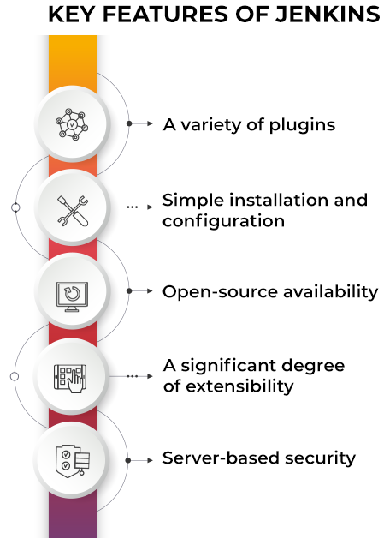
,
FEATURES OF JENKINS

Slide 9
PLUGINS
A plugin is an enhancement to the Jenkins systems. They help extend Jenkins capabilities and integrated Jenkins with other software.
Plugins can be downloaded from the online Jenkins plugin repository and loaded using the Jenkins Web UI or CLI.
Currently, the Jenkins community claims over 1500+ plugins available for a wide range of uses.
,
Icons | Description
 | Kubernetes plugin is great for automating build agents on a Kubernetes cluster
 | Git plugin allows jobs to connect to remote repositories
 | EC2 plugin is used for Jenkins to automatically provision AWS
 | JUnit plugin provides graphical visualizations

Slide 10
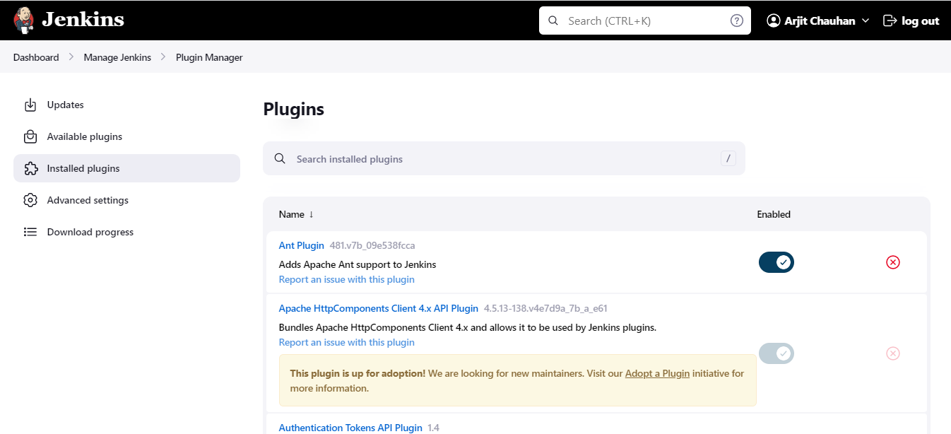
PLUGINS MANAGER
,

Slide 11
JENKINS PIPELINE AND JENKINSFILE
The role of Jenkins in DevOps is primarily due to the pipeline-as-code concept followed by Jenkins.
The continuous pipeline is an automated process for obtaining software from version control to users and customers.
Jenkins Pipeline is defined using a text file called the Jenkinsfile.
The pipeline implements as code using Groovy Domain-specific language through an editor or the configuration page on Jenkins instance.
Jenkinsfile give leverage to the developer to easily access or edit or check the code anytime.
,

Slide 12
JENKINSFILE
Two types os syntax using which we can define a Jenkinsfile:
-> Declarative Pipeline syntax
-> Scripted Pipeline syntax
Declarative Pipeline syntax ->
The declarative syntax is a new feature that used code for the pipeline . It provides a
limited pre-defined structure. Thereby, it offers an easy and simple continuous delivery
pipeline.
(We will create Jenkinsfile in SCM)
Scripted Pipeline syntax ->
The scripted pipeline syntax is the old traditional way to write the Jenkinsfile on Jenkins
web UI. Moreover it follows the groovy syntax and helps to develop a complex pipline
as code.
(It is written in Jenkins dashboard)
,

Slide 13
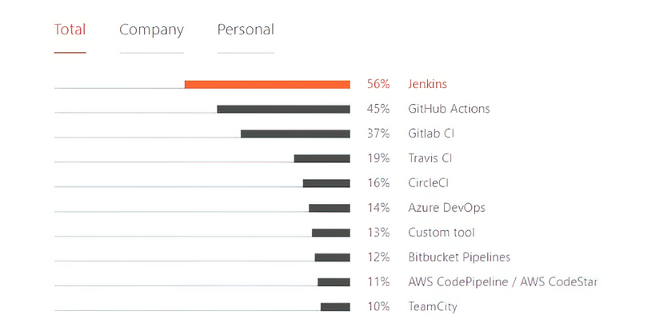
JENKISN VS OTHER CI/CD TOOLS
Jenkins : the most-used CI/CD solutions.
No expenses required
Limitless integrations
Active community
,

Slide 14
ADVANTAGES
It is open source and it is user-friendly, easy to install and does not required additional installations or components. It is free of cost.
Easily Configurable: Jenkins can be easily modified and extended. It deploys code instantly, generates test reports.
Platform independent: Jenkins is available for all the platform and different operating system.
Rich Plugins ecosystem: The extensive pool of plugins makes Jenkins flexible and allow building, deploying and automating across various platform.
Issuse are detected and resolve almost right way which keeps the software in a state where it can be released at any time safely.
Most of the integration work in automated. Hence fewer integration issuses. This save both time and money over the lifespan of a project.
,

Slide 15
INSTALLING AND CONFIGURING JENKINS
Prerequisites of Jenkins Installation
Ubuntu server with 18.04, 20.04 or 22.04
256 MB of RAM
1 GB of drive space for solo use. However, no less than 10 GB is recommended if jenkins run inside a Docker container
4GB+ of RAM
50GB+ of drive space
Oracle JDK 8 or 11
Jenkins by default runs on port 8080
,

Slide 16
STEP -1 Installing Java Development kit
Sudo apt-get install openjdk-11-jdk
Step -2 Installing Jenkins
curl -fsSL https://pkg.jenkins.io/debian-stable/jenkins.io.key | sudo tee \
/usr/share/keyrings/jenkins-keyring.asc > /dev/null
echo deb [signed-by=/usr/share/keyrings/jenkins-keyring.asc] \ https://pkg.jenkins.io/debian-stable binary/ | sudo tee \ /etc/apt/sources.list.d/jenkins.list > /dev/null
sudo apt-get update
sudo apt-get install jenkins
sudo systemctl start jenkins.service
,

Slide 17
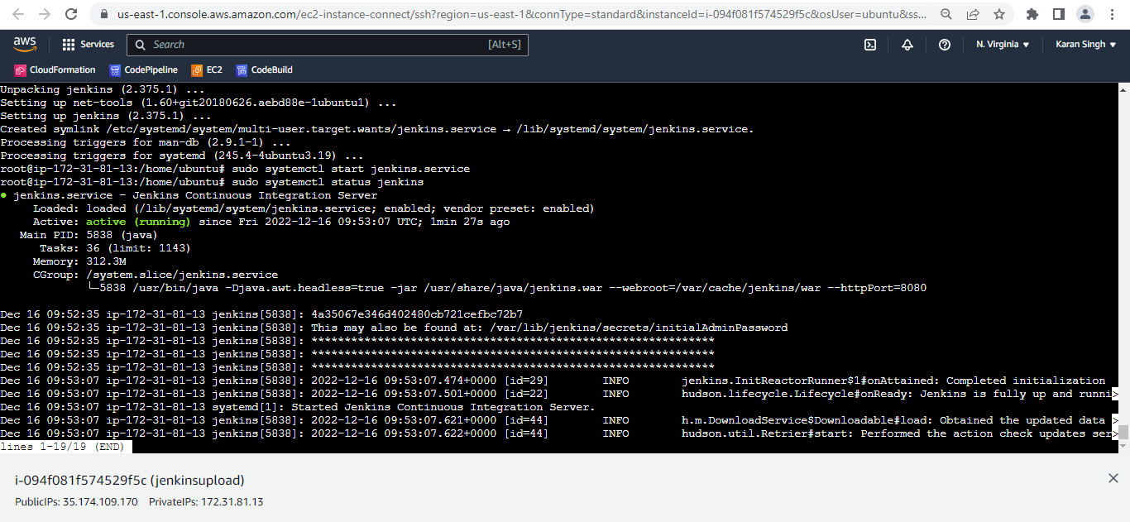
sudo systemctl status jenkins
,

Slide 18
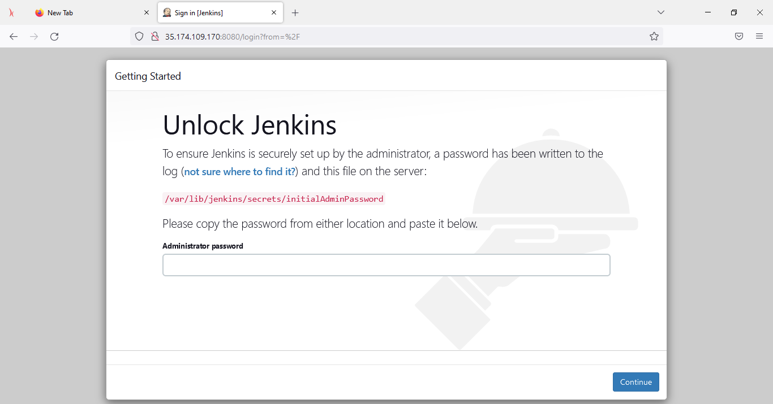
Now copy the IP and paste in browser with port 8080
sudo cat /var/lib/jenkins/secrets/initialAdminPassword
,

Slide 19
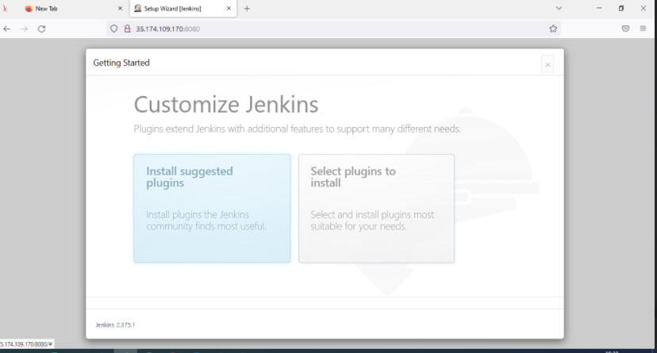
Customize Jenkins
,

Slide 20
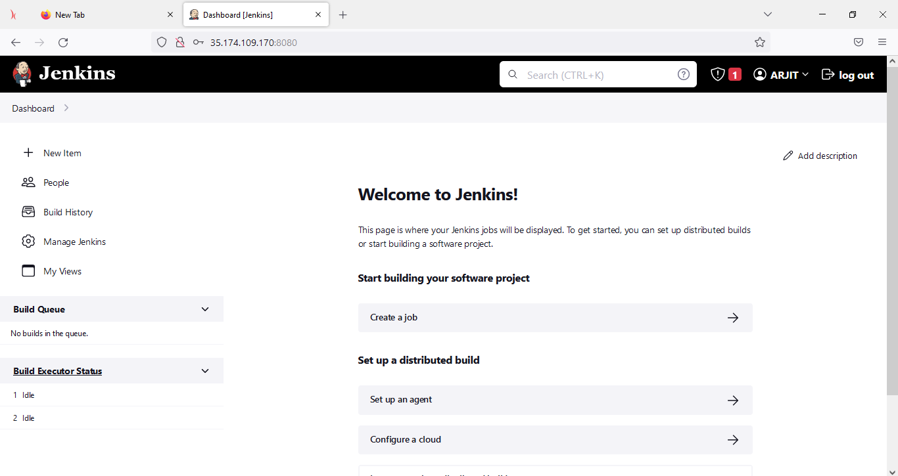
Dashboard Jenkins
,

Slide 21
,
DEMO –CI/CD OF React Application

