Slide 1
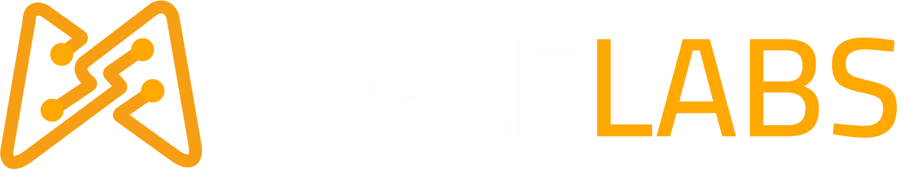
NFT Fundamentals
Ravinder Singh| Blockchain Developer
Gurpreet Singh | Vertical Head Blockchain

Slide 2

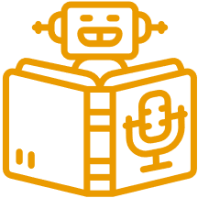
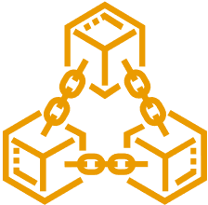
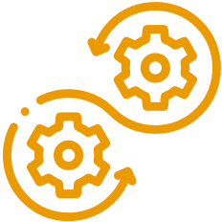

MOOGLELABS - SERVICES
Decoding Innovation In AI/ML, Blockchain, DevOps, Metaverse and Data Science
Many organizations are afraid to take the leap toward AI/ML, Blockchain, DevOps, and Data Science. MoogleLabs makes the journey streamlined and smooth for you. Founded by seasoned IT experts, the company has the resources to help your business embrace new-age technology.
At MoogleLabs, we help you compete effectively by leveraging cutting-edge technology and in this endeavor, we have a talented team, which is certified in the technologies it works on. We have transformed businesses with our deep understanding of technology that can be utilized for various industries. The company is known for building a great client-business relationship by being transparent throughout the whole journey. MoogleLabs is always ready to better itself to provide the best services to its clients.
Artificial Intelligence
Machine Learning
Blockchain
DevOps
Data Science
Our Applied AI brings roadmap to scale enterprise-grade solutions, with the power of analytics, automation and next-level computing.
Scale up your business with future-ready ML-powered applications integrated with AR/VR, image & video analytics.
We help you build a secured decentralized solution for Smart Contracts, Crypto-token and NFT Marketplace.
We specialize in DevOps managed services including CI/CD, Infrastructure Management, Cloud Managed Services, DevSecOps, and AI Ops.
Uncover hidden stories in data and turn it into maximized revenue opportunities using qualitative and quantitative data processing techniques.

Slide 3
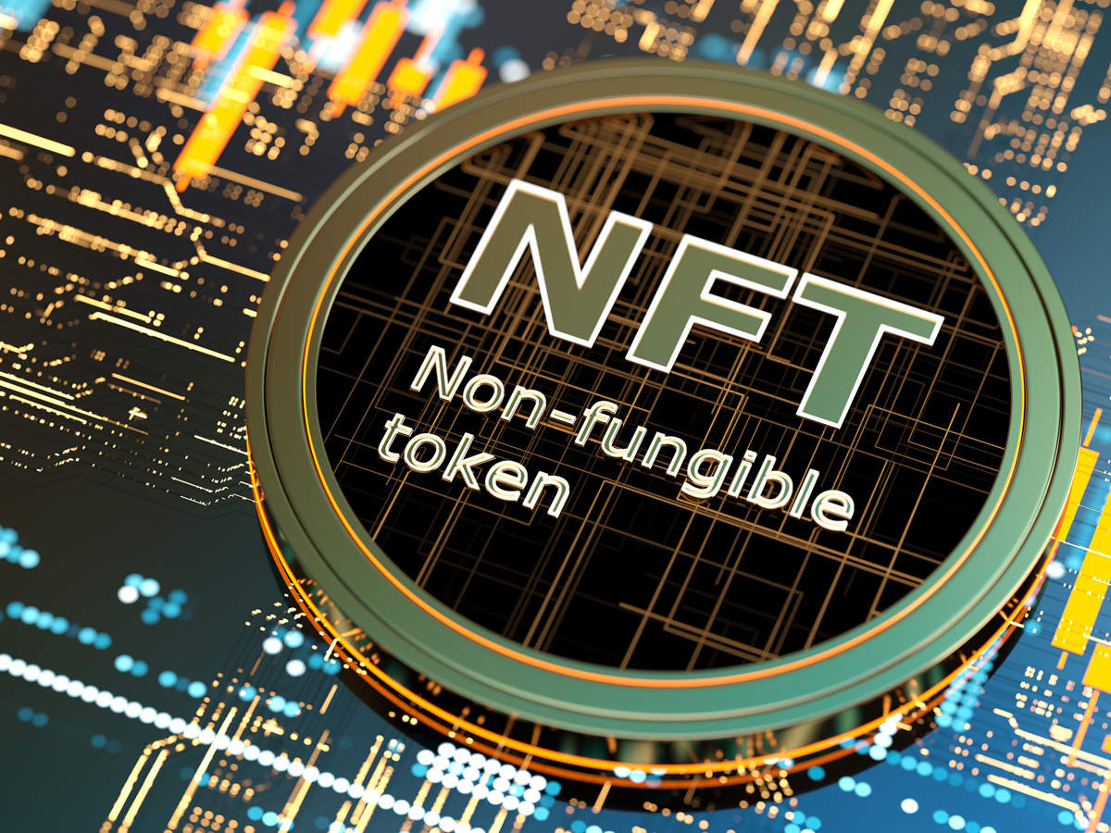
Overview
What are NFTs?
Key characteristics of NFT’s
NFT Use Cases
Dynamic NFTs vs Static NFTs
How to Mint an NFT
NFT Architecture
Top NFT Marketplaces of February 2023
Top 10 Most Expensive NFTs Ever Sold

Slide 4
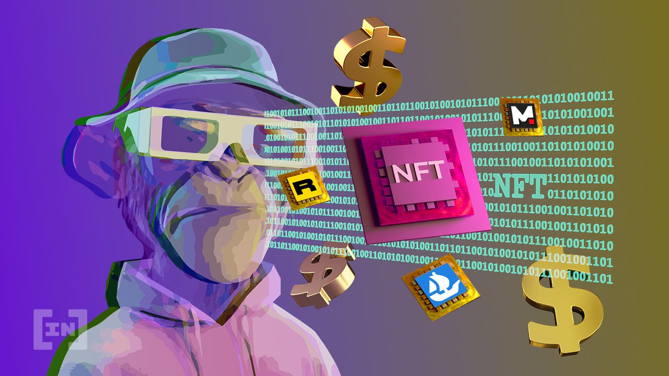
What are NFTs?
NFT is the abbreviation for Non-Fungible Token. To get things clear, let’s start by understanding the 2 principles notions:
What is a token?
”In the Blockchain ecosystem, any asset that is digitally transferable between two people is called a token” These tokens are issued on a blockchain, most often on Ethereum. Depending on the properties attributed to them, they have a different classification and uses.
What is fungibility?
Fungibility means that the individual units of an asset are interchangeable and essentially indistinguishable from one another. A currency is a classic example of a fungible asset. $50 is always $50

Slide 5
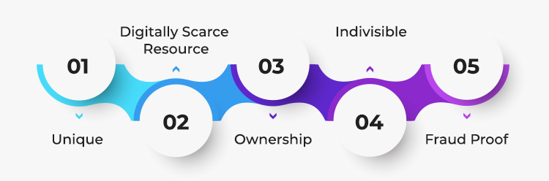
Key characteristics of NFT
NFTs are Unique: Each NFT has a unique property usually stored in tokens metadata. NFTs are unique in their character, and no two NFTs are the same. On the contrary, an original image .jpg file is the same as its copy, a .jpg file.
Indivisible – Most NFTs cannot be split into smaller denominations; you cannot buy or transfer a fraction of NFTs.
Ownership– These tokens guarantee the ownership of the asset transferred.
Fraud proof– They are easily transferable and fraud-proof.

Slide 6
NFT Use Cases
Digital Assets: NFTs can be used to represent ownership of digital assets such as art, music, or video. The core idea is that NFTs can be used to certify that a certain digital asset is original and has been verified by the creator. This would help reduce piracy and ensure that creators are properly compensated for their work.
Decentralized Marketplaces: NFTs can also be used to create decentralized marketplaces. For example, an NFT could represent a piece of virtual real estate in a virtual world. By buying an NFT, you would own that piece of property and would be able to sell it or rent it out to other users.
Loyalty points or Rewards: Another interesting use case for NFTs is loyalty points or rewards. For example, a company could issue NFTs that can be redeemed for discounts or special offers. This would give customers an incentive to keep using the company’s products or services.
Physical Assets: NFTs can be used to represent ownership of physical assets. For example, a car company could issue NFTs that represent ownership of a certain model of car. The NFT would be stored on a blockchain and would be transferable to another owner if the car is sold.
Gaming Applications NFTs can be used for gaming applications. For example, an NFT could represent a character in a game. The NFT would be stored on a blockchain and would be transferable to another player if the original owner decides to sell it.

Slide 7
Dynamic NFT VS Static NFT

Slide 8
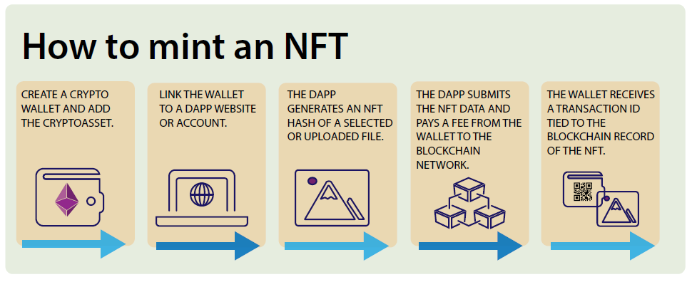

Slide 9
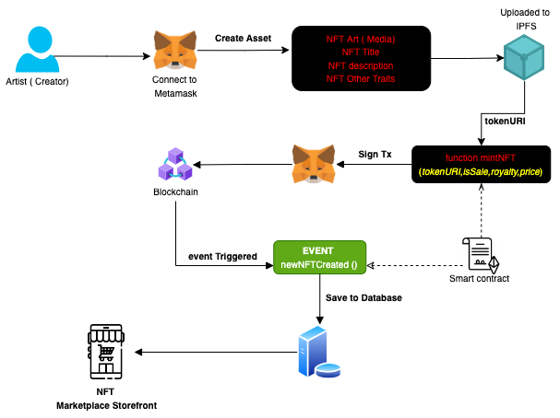
NFT Architecture

Slide 10
Top NFT Marketplaces of February 2023
OpenSea – The core cryptocurrencies used on OpenSea are Ethereum, Solana, and USDC
Rarible - Rarible allows users to buy and sell art, collectibles, video game assets and NFTs. You can buy and deal on Rarible with Ethereum, Flow and Tezos.
NBA Top Shot - You can buy video clips, play highlights and art for both the NBA and the WNBA
Binance - Binance NFT offers the typical digital assets found on other major platforms: artwork, gaming items, and collectibles. A major advantage of Binance NFT is that it charges very low fees. The platform only deducts a 1% trading fee. It’s also a user-friendly platform built using similar technology and layouts as their exchange.
Nifty Gateway: This marketplace focuses on artwork, especially artwork from celebrities and top artists. Nifty Gateway is known for hosting expensive and exclusive NFT sales, including digital artist Pak’s “The Merge,” which sold for $91.8 million.

Slide 11
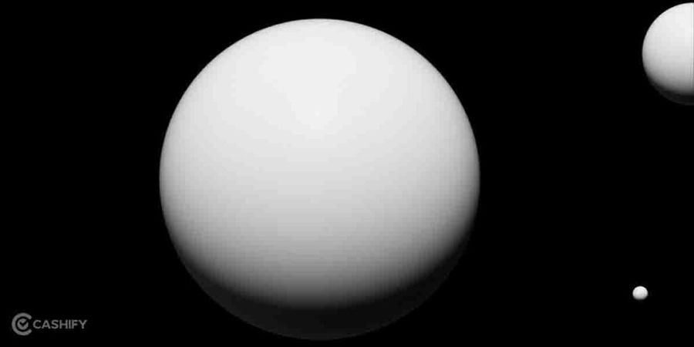
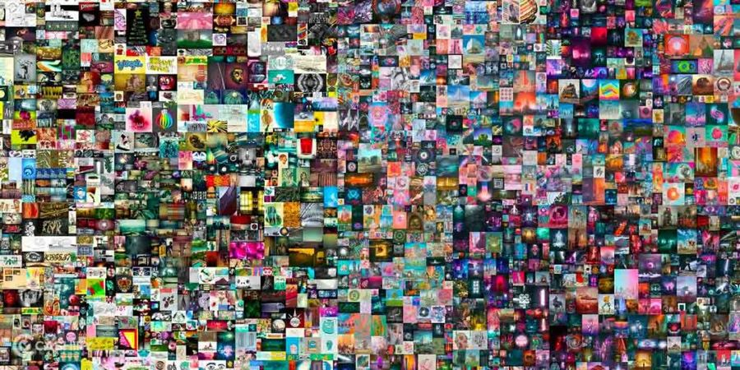
Top 10 Most Expensive NFTs Ever Sold
1. The Merge(312,686 pieces) – $91.8 Million
2. Everyday: The First 5000 Days – $69.3 million
3. Clock – $52.7 Million
4. HUMAN ONE – $28.9 million
5. CryptoPunk #5822 – $23.7 million
6. Alien Cryptopunk #7523 – $11.75 million
7. TPunk #3442 – $10.5 Million
8. CryptoPunk #4156 – $10.26 million
9. CryptoPunk #5577 – $7.7 million
10. CryptoPunk #3100 – $7.57 Million

Slide 12
THANK YOU

