Slide 1
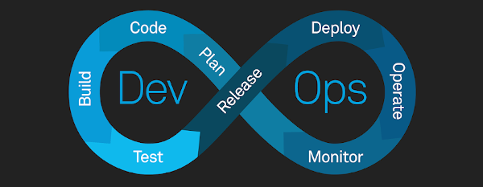
DevOps: Age Of CI/CD
Gaurav Raturi
DevOps Engineer
MoogleLabs

Slide 2
Table of Content
Introduction TO CI/CD
CI/CD
CICD Orchestrator
Rise of CI/CD
Reasons to adopt CI/CD
The Business impact & benefits of CI/CD
Other benefits of CI/CD to Business
Stage for Success
Gauge the effectiveness of CI/CD in DevOps organization
Introduction to CI/CD Tools
CI/CD Tools
Product Comparison
Decoding Innovation In AI/ML, Blockchain, DevOps, MetaVerse and Data Science

Slide 3
Introduction to CI/CD
CI/CD is a method to frequently deliver apps to customers by introducing automation into the stages of app development. The main concepts attributed to CI/CD are continuous integration, continuous delivery, and continuous deployment.
CI/CD is a solution to the problems integrating new code can cause for development and operations teams.

Slide 4
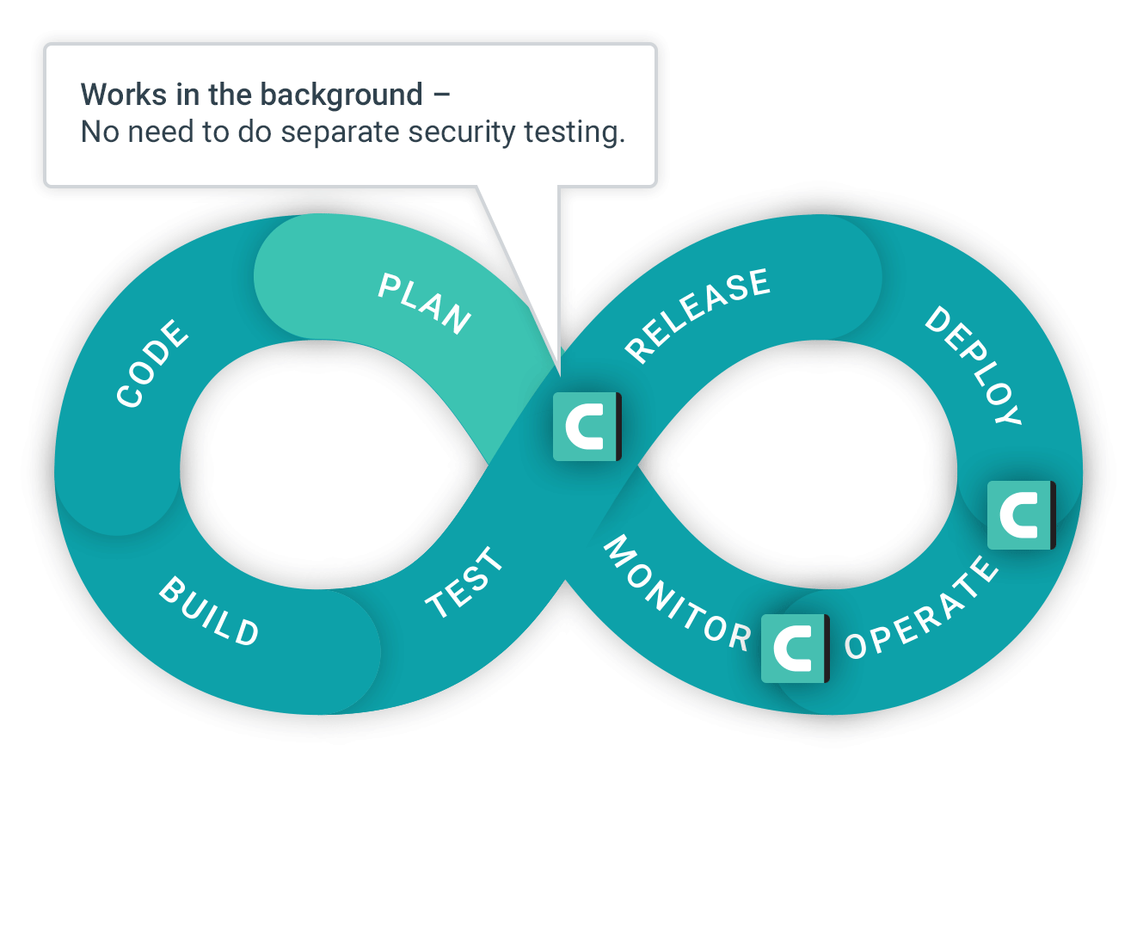
CI/CD
Continuous Integration: The "CI" in CI/CD always refers to continuous integration, which is an automation process for developers. Successful CI means new code changes to an app are regularly built, tested, and merged to a shared repository.
Continuous Delivery: Following the automation of builds and unit and integration testing in CI, continuous delivery automates the release of that validated code to a repository. So, in order to have an effective continuous delivery process, it’s important that CI is already built into your development pipeline. The goal of continuous delivery is to have a codebase that is always ready for deployment to a production environment.
Continuous Deployment: As an extension of continuous delivery, which automates the release of a production-ready build to a code repository, continuous deployment automates releasing an app to production.

Slide 5
CI/CD (Cont.)
Phase 1. Commit: When developers complete a change, they commit the change to the repository. Raise a PR and invite the other team members working on the project to see if there is any conflicts.
Phase 2. Merge and Automatically Release to Repo: After the approvals perform merge the codes into one branch which is used for production.
Phase 3. Build: The merging of the code into the production branch triggers the pipeline and Build phase runs. Source code from the repository is integrated into a build.
Phase 4. Deploy: The built version is delivered to production. This deployment could be on ECS cluster or S3 bucket or the VM to deploy the website aur apk in case of mobile deployment.
Phase 5. Automate tests: In this phase, we run automated tests to validate our code’s correctness and the behavior of our product. The test stage acts as a safety net that prevents easily reproducible bugs from reaching the end-users. The responsibility of writing tests falls on the developers. Depending on the size and complexity of the project, this phase can last from seconds to hours.

Slide 6
CI/CD Orchestrator

Slide 7
Rise of CI/CD
Around 2001, there was a lot of talk going around in the tech circles about Continuous Integration and Extreme programming.
Continuous Delivery or Deployment was still not prevalent then, and it would be a few more years before they came to the scene.
From 2006-2008 Hudson took the developer community by storm and won awards and accolades from the community. Since Hudson was open source, it saw widespread adoption across big and small organizations.
In 2010 Sun Microsystems was acquired by Oracle and Jenkins was born. Jenkins continued to see widespread adoption across the technology industry.
Jenkins is still the most widely used CI/CD orchestrator in the industry.

Slide 8
Rise of CI/CD (Cont.)
Gitlab has taken the game to the next level in this area. All you need to do is quickly look at their features page and realize there are very few things in the CI/CD process flow that it cannot do.
Azure DevOps was one of the earliest to take a holistic approach to CI/CD. Instead of building just orchestration, it tried to integrate other tools like collaboration, artifacts, deployment, security, etc.
AWS Code set of tools, namely Code Build, Code Deploy, Code Pipeline, and Code Commit, have come a long way from “also ran” to strong contenders in the CI CD space. With strong Integration with AWS native services, these tools provide a solid set of capabilities for AWS native implementation.
Cloud-Native Continuous Integration Tools, 2019 report, Google Cloud build beat all the heavyweight contenders to come on top. Under the hood, Google Cloud Build uses its open-source project, Tekton, which it has donated to the Continuous delivery foundation.

Slide 9
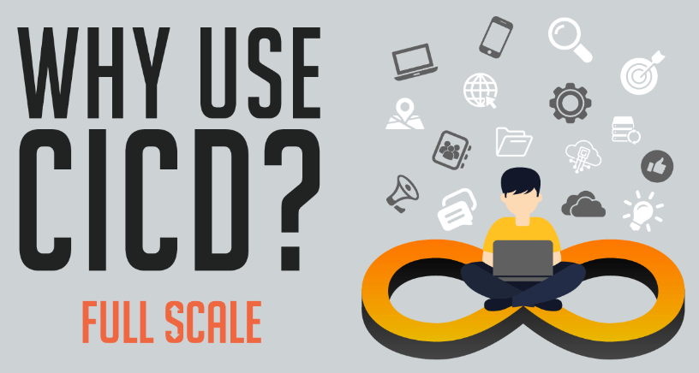
Reasons to Adopt CI/CD
Continuous Testing
With CI/CD’s automated testing capabilities, codes are checked instantly. This enables the programmers to find the bugs right away and apply the necessary changes.
Quicker Release
Releasing new system updates is quicker with CI/CD. Because CI/CD merges new codes to the current system while checking for mistakes, the release of updates will be faster.
Efficient Operation
Developers who are working remotely or separately from each other. Being able to add a smaller amount of codes and fix them, makes a more efficient operation.
Customer Satisfaction
With CI/CD, bugs are fixed while still in the development phase. And, continuous delivery means feedback from users will be easy to integrate into the new system. Providing bug-free and quick updates on your system will result in customer satisfaction.

Slide 10
The Business impact & benefits of CI/CD
Bring Products to Market Faster
Organizations that have effectively implemented CI/CD can bring new products and features to market faster and immediately start generating revenue from the features they deploy rather than waiting for the entire app to be completed before they can launch.
Instead, teams already know the code is in good shape because they’ve automated testing, and continuous delivery means code is automatically deployed if it meets predefined criteria.
Allows Developers to Deliver Products Consumers Want Now
Over the last couple of years, customer-centricity has been a core focus for businesses.
CI/CD enables organizations to respond to consumer needs as they evolve
Teams have the flexibility to update applications and build and deploy new ones in response to emerging trends, new markets, and evolving expectations.

Slide 11
The Business impact & benefits of CI/CD (Cont.)
CI/CD plays a crucial role in shortening time to value
Developers allow to experiment with new technologies and try out new ideas. Teams can test different features with real users in parallel and use their findings to ensure.
CI/CD supports customer outcomes from a technical standpoint
When a product goes to market, organizations typically monitor and record user activity and collect feedback from consumers. This allows them to make sure that software bugs and usability issues don’t go undetected and cause lasting damage to the product’s (or the company’s) reputation.
Boosts DevOps efficiency
With CI/CD, teams can implement a standardized delivery mechanism that automatically merge codes, run tests, and deploy changes to multiple production environments to ensure that code is always in a release-ready state.

Slide 12
The Business impact & benefits of CI/CD (Cont.)
CI/CD Improves App Quality
One of the biggest concerns organizations have about implementing CI/CD is that they’re giving up quality in favor of speed. CI/CD means organizations don’t need to choose to prioritize quality over speed.
Instead, it offers the best of both worlds by enabling tight collaboration between developers and operations teams, which, in turn, means problems are identified and fixed faster and early in the development lifecycle.
Supports Cloud-Based App Development
CI/CD enables benefits like scalability, elasticity, improved performance characteristic of cloud-native applications.
Boost Profit
Teams spend less time on testing and bug fixes, meaning organizations spend less money on tasks that don’t provide any value to the business or its customers.

Slide 13
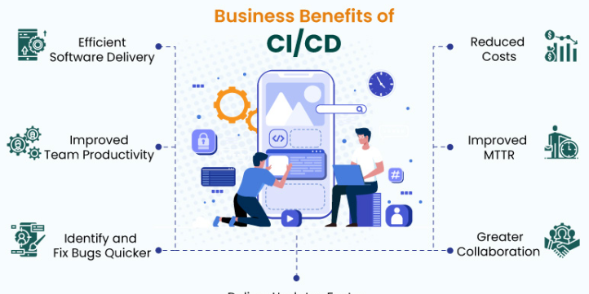
Other benefits of CI/CD to Business

Slide 14
Other benefits of CI/CD to Business (Cont.)
1) Efficient Software Delivery
With continuous delivery, your team can automatically build, test, and prepare code changes for release to production, enabling a more efficient and rapid software delivery.
2) Improved Team Productivity
CI/CD practices improve your team’s productivity by freeing developers from manual tasks, reducing the number of errors and bugs deployed to customers.
3) Identify and Fix Bugs Quicker
With CI/CD, your team can perform more frequent and comprehensive testing and quickly identify and address bugs earlier.
4) Deliver Updates Faster
Continuous delivery enables faster and frequent delivery of updates to customers.

Slide 15
Other benefits of CI/CD to Business (Cont.)
5) Greater Collaboration
CI/CD promotes closer team communication by enabling development, operational, management, and QA teams to collaborate on technologies, practices, and priorities.
6) Improved MTTR
Smaller code changes and quick fault isolation enabled by CI/CD practices reduce the Mean Time To Resolution (MTTR). CI/CD plays a vital role in keeping failures to a bare minimum and quickly recovering from any failures that do happen.
7) Reduced Costs
Automation in the CI/CD pipeline minimizes the number of errors that can occur in the many repetitive steps of CI and CD. It also frees up developers’ time that could be spent on product development as there won’t be many code changes to fix since the errors are identified quickly.

Slide 16
Stage for success
Set the Stage for Success
Make sure you nail CI before introducing CD: Start with a strong foundation—consistent tooling, configurations, libraries, etc., should all be in place before CD enters the mix.
Separate services: It’s crucial that series are separate from one another/should be isolated and abstracted to ensure that changes made to one feature won’t impact the others.
Automate Repeatable Processes: While writing code is still a very “human” process, many aspects of the development lifecycle can be automated. CI/CD automation streamlines the software development cycle, allowing teams to work through the feedback cycle faster and consistently deliver high-quality products with fewer instances of code errors/bugs.
Invest in the proper tooling and infrastructure: Make sure you invest in the underlying infrastructure and the correct tooling to support CI/CD. Need the right tools to expedite the process/eliminate repetitive manual tasks.

Slide 17
Gauge the effectiveness of CI/CD in DevOps organization
According to DevOps Research and Assessment, or DORA, you can prioritize just four metrics to measure the effectiveness of your DevOps organization—two to measure speed, and two to measure stability:
Speed:
1. Lead Time for Changes - Code commit to code in production
2. Deployment Frequency - How often you push code
Stability:
3. Change Failure Rate - Rate of deployment failures in production that require immediate remedy. (Rollback or manual change)
4. Time to Restore Service (MTTR) - Mean time to recovery.

Slide 18
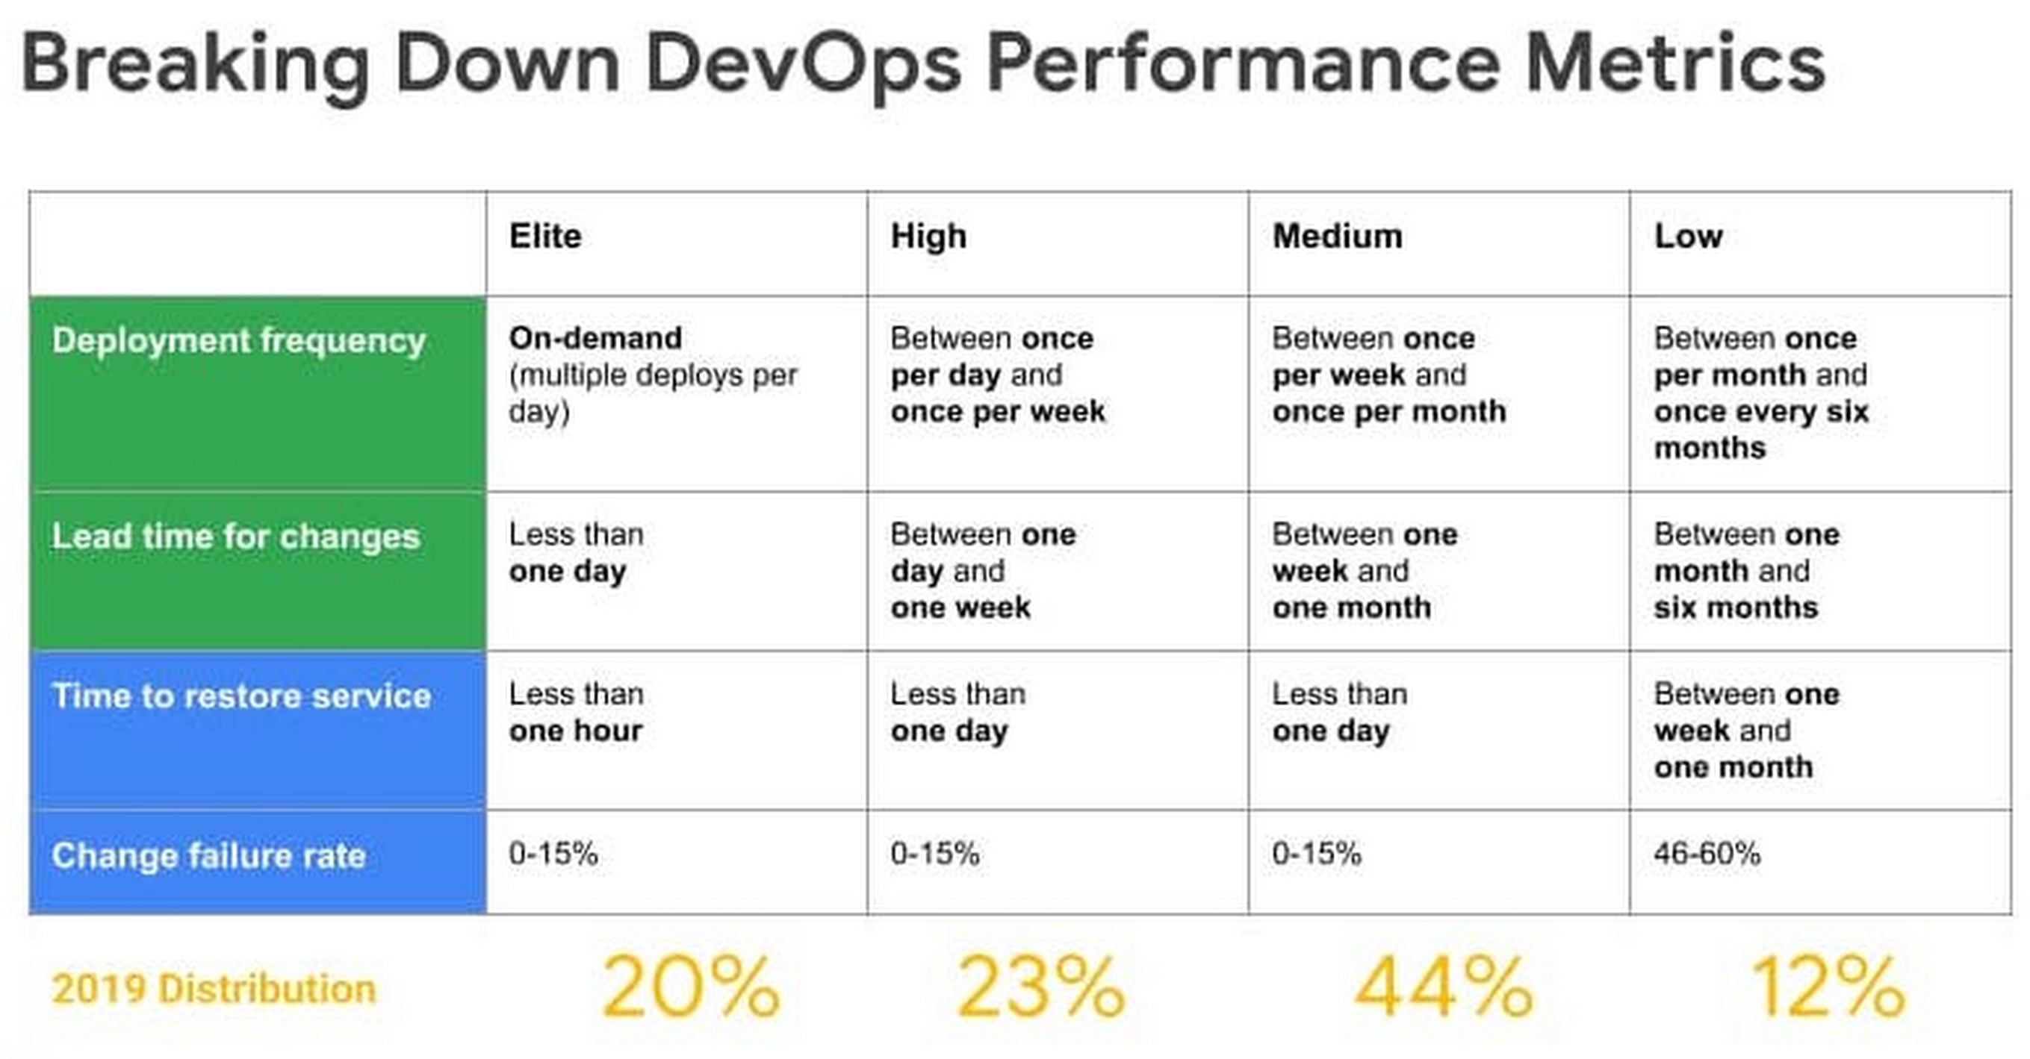

Slide 19
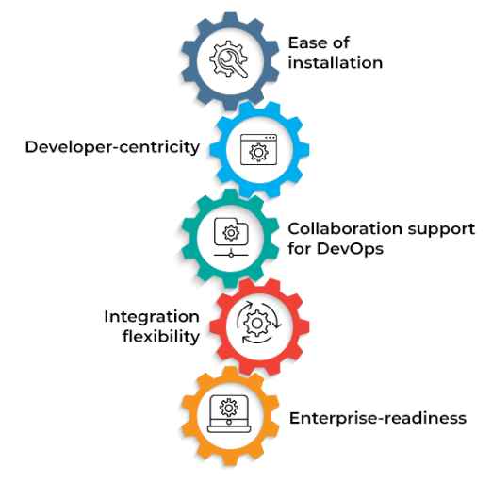
Introduction to CI/CD Tools
Continuous integration and continuous delivery (CI/CD) tools are software solutions that leverage automation to support DevOps and speed up application delivery to end-users.

Slide 20
CI/CD Tools
GitLab
Overview: GitLab is a collection of tools intended to be used in various software development life cycle stages.
Key features:
Ease of installation: Branching tools allow users to create, view, and manage project data and codes to simplify installation and use.
Developer-centricity: It offers container scanning, dynamic application security testing (DAST), dependency scanning, and static application security testing (SAST) to support developers.
Integration flexibility: Integration with popular services such as Campfire, Flowdock, Jira, Pivotal Tracker, and Slack are available to users.
Enterprise-readiness: It maximizes the overall return on software development for enterprises by delivering software faster while strengthening security and compliance.

Slide 21
CI/CD Tools (Cont.)
AWS Pipelines
Overview: Amazon Web Services (AWS) provides CI/CD tools designed to accelerate the software development cycle.
Key features:
Ease of installation: It is possible to develop, test, and deploy applications written in Node.js, Python, Java, PHP, Ruby, C/C++,.NET, Android, and iOS on Linux, macOS, and Windows.
Developer-centricity: With ease, users can create and push images to container registries such as ECR (Elastic Container Registry).
Integration flexibility: Pipeline supports a diverse set of community-developed build, test, and deployment apps, as well as many of extensions like Google Play Store
Enterprise-readiness: AWS services such as Amazon Simple Storage Service (Amazon S3), AWS Secrets Manager, AWS CodeCommit, AWS CodeBuild, and AWS CodeDeploy provide artifact storage, parameter management, automated testing, builds, deployment, and change management for serverless applications across multiple AWS accounts

Slide 22
CI/CD Tools (Cont.)
Azure Pipelines
Overview: Azure Pipelines simplifies the creation and testing of code projects prior to making them freely accessible.
Key features:
Ease of installation: It is possible to develop, test, and deploy applications written in Node.js, Python, Java, PHP, Ruby, C/C++,.NET, Android, and iOS on Linux, macOS, and Windows.
Developer-centricity: With ease, users can create and push images to container registries such as Docker Hub and Azure Container Registry.
Integration flexibility: Pipeline supports a diverse set of community-developed build, test, and deployment apps, as well as hundreds of extensions ranging from Slack to SonarCloud.
Enterprise-readiness: Enterprises can benefit from simple build chaining and multi-phased builds that include support for release gates, test integration, reporting, etc.

Slide 23
CI/CD Tools (Cont.)
Docker
Overview: Docker is a containerization solution widely used in DevOps and CI/CD workflows.
Key features:
Ease of installation: Docker supports application development for computing environments, including public, hybrid, and multi-cloud. It also includes access to free public repositories.
Developer-centricity: Docker offers open-source developer tools, a thriving community, and pre-built images for developer use.
Integration flexibility: It allows users to develop applications in any language and natively integrates with a wide range of third-party platforms like Azure, GitHub, etc.
Enterprise readiness: The Docker Hub feature streamlines enterprise use by integrating with GitHub and enabling deployment using a centralized platform.

Slide 24
CI/CD Tools (Cont.)
Jenkins
Overview: Jenkins is an open-source server for automation that is free to use. In software development, it aids in the automation of the processes associated with creating, testing, and deploying, hence helping the methods of continuous integration and delivery.
Key features:
Ease of installation: It is a Java-based tool that is ready to work right out of the box on various operating systems, including Windows, Linux, macOS, and other Unix operating systems.
Developer-centricity: It offers greater control and flexibility of configuration to developers, owing to its web interface.
Integration flexibility: Jenkins’s functionality can be expanded via its plugin architecture, which opens the door to many possibilities for the tools Jenkins can integrate with.
Enterprise-readiness: Enterprises can benefit from Jenkins Enterprise, a powerful CI/CD tool built on Jenkins’ open-source capabilities.

Slide 25
Product Comparison
 | Offerings | Pricing | Verdict
AWS Pipeline | AWS Code Pipeline allows you to model the different stages of your software release process using the console interface, the AWS CLI, AWS CloudFormation, or the AWS. | AWS Code Pipeline costs $1.00 per active pipeline* per month. To encourage experimentation, pipelines are free for the first 30 days after creation. An active pipeline is a pipeline that has existed for more than 30 days and has at least one code change that runs through it during the month. There is no charge for pipelines that have no new code changes running through them during the month. An active pipeline is not prorated for partial months. It is priced at $40 per Microsoft-hosted CI/CD parallel task and $15 per additional self-hosted CI/CD parallel job with unlimited minutes. | Aws pipelines are most widely used and ease offering service which allows you to source the code from bitbucket, GitHub and GitLab. Therefore it is one of the best for first time and experience user.

Slide 26
Product Comparison
 | Offerings | Pricing | Verdict
Azure Pipeline | Azure Pipelines ensures that every open source project has rapid CI/CD capabilities. Further, users receive ten complimentary parallel tasks with unlimited build minutes for any open source project. | It is priced at $40 per Microsoft-hosted CI/CD parallel task and $15 per additional self-hosted CI/CD parallel job with unlimited minutes. | The features are all synchronized making it extremely easy to use. However, it might be challenging to implement environment-specific adjustments.
GitLab | GitLab is a single application for the entire software development lifecycle, from project planning and source code management to delivery and upkeep. This reduces the need to maintain multiple tools in the stack. | GitLab is free for individual users and costs $19 per user for teams. | Gitlab is an extremely popular CI/CD tool, mainly due to its free tier, which offers 5 GB of complimentary storage and 10 GB of data transfers. However, it does not provide premium consultancy services like large-scale integrations.

Slide 27
Product Comparison
 | Offerings | Pricing | Verdict
Docker | Docker is the premier platform for container-based CI/CD projects. It has a localized desktop version for independent use and a centralized hub for enterprises. | Pricing for this CI/CD tool starts at $7 per user on a monthly basis. | Docker is among the leading options for individuals, teams, and organizations looking to adopt containerization for CI/CD purposes. However, large-scale deployments may be costly for independent developers.
Jenkins | Despite being a free tool, it provides hundreds of ready-to-use plug-ins in its update center to reduce developer effort. Also, it has a large community with regular events and workshops. | Although users must pay for the hosting server, Jenkins is free to use. | Jenkins is easy to set up and provides the largest integration libraries among open source CI/CD tools. However, the Jenkins dashboard can be difficult to use when executing multiple jobs simultaneously.

Slide 28
Decoding Innovation In AI/ML, Blockchain, DevOps, MetaVerse and Data Science
Many organizations are afraid to take the leap toward AI/ML, Blockchain, DevOps, and Data Science. MoogleLabs makes the journey streamlined and smooth for you. Founded by seasoned IT experts, the company has the resources to help your business embrace new-age technology.
At MoogleLabs, we help you compete effectively by leveraging cutting-edge technology and in this endeavor, we have a talented team, which is certified in the technologies it works on. We have transformed businesses with our deep understanding of technology that can be utilized for various industries.
The company is known for building a great client-business relationship by being transparent throughout the whole journey. MoogleLabs is always ready to better itself to provide the best services to its clients.
Our Services:
Artificial Intelligence
DevOps
Machine Learning
Data Analysts
Blockchain
Metaverse

Slide 29
For more information please visit:
https://www.mooglelabs.com/

